Slide 1
2021 MLP Progress
Yonsei University
Machine Learning Project Team 09
2021.04.08

Slide 2
Outline
1. Proposal – DeepRL
Robot Path Planning
2. Proposal – Item Classification
Item Pod Assignment
3. Proposal - Association Analysis of item for PSA
Pod Station Assignment
4. Proposal – Queuing Network Model
Robot Storage Assignment

Slide 3
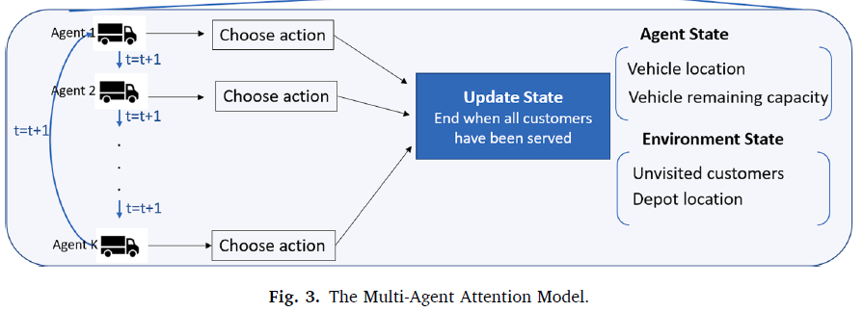
1. Proposal – DeepRL
Suggestion
Multi-agent Deep Reinforment Learning with Adversarial agent
Multi-agent Deep RL

Slide 4
1. Proposal – DeepRL
RL
Problem
Overall logistics → Vehicle Routing Problem only
Fix other setting (ex. Task allocation, Order assignment)
State, Action, Reward
Replenishment, pick station status and action (Embedded, Empty)
Mobile robot location(for every point) and action(←↑↓→)
Reward: -Cost
Agent
Normal: minimize total cost
Adversarial agent : maximize total cost
Intercept other pod due to urgent situation
Simply move around w/o pick & order
Training Algorithm (Next)

Slide 5

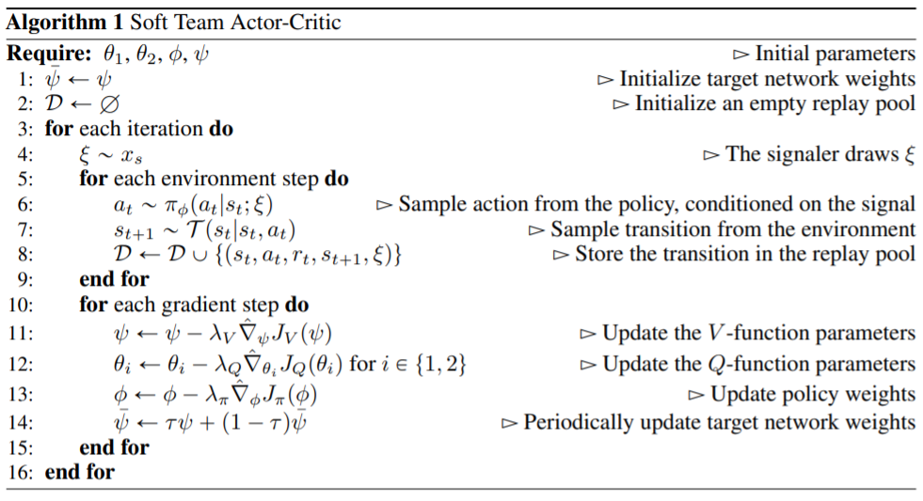
1. Proposal – DeepRL
RL – Training Algorithm
Soft Actor-Critc (SAC) → Only single agent
Off-policy deep RL based on maxent
Multi-Agent SAC (STAC)¹
Centralized training with decentralized execution
Exploit extra information during training
Multi-agent planning
Multi-agent deep RL (cooperative behavior)

Slide 6
1. Proposal – DeepRL
Limitation
Little RL background
Source code & Environment Setup
No RAWSim-O
Adversarial policy algorithm ¹
Unity ²
MLCS RL …
Other

Slide 7
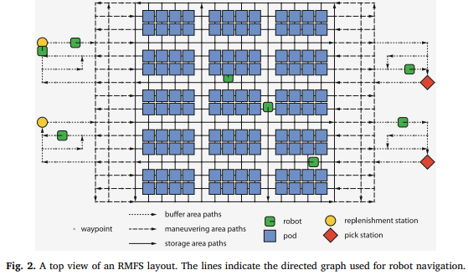
Robotic Mobile Fulfillment System
Replenishment
Pick

Slide 8

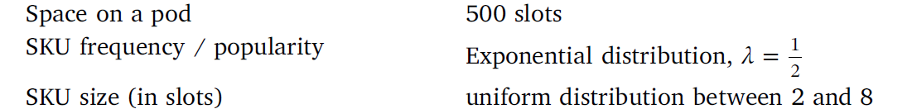
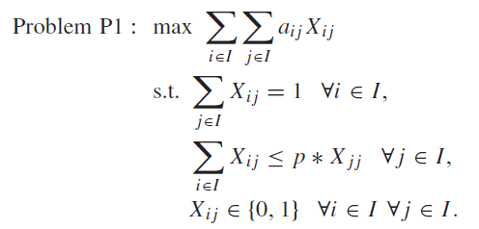
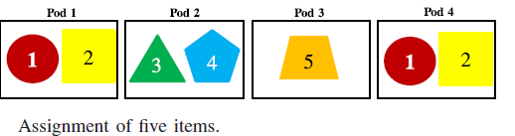
2. Proposal – Item classification
Existing Papers
“Decision rules for robotic mobile fulfillment systems” , M.Merschformann,…
Set in the Orders tap
Set SKU size, item distribution, Order distribution
Uniform distribution, SKU size is 2~8 items in this paper
Item Classification is distributed in pods according the set distribution, but not applicated in a pod
“Item Assignment Problem in a Robotic Mobile Fullfillment System”, Hyun-Jung Kim..
Calculate Similarity value of Two Items from Frequency (Clustering)
Maximize the Sum of similarity values
Optimization Algorithm : Heuristic Algorithm ( to revise the varied similarity), Reoptimization Algorithm (to representation item)

Slide 9
2. Proposal – Item classification
Items classification along the..
Existing papers didn’t mention the classification of items
Classification Based on Frequency, Similarity, Importance etc.
Find optimal arrangement
Using Classification algorithm with proper weight
Store on a Pod based on Classification
Arrange Pods in Inventory Area based on Frequency
Algorithm
Constructive Heuristic : Select High Demand Item
Heuristic Initialization Extensions : Select Representation Item based on matrix
Reoptimization Heuristic : Change when changing Similarity

Slide 10
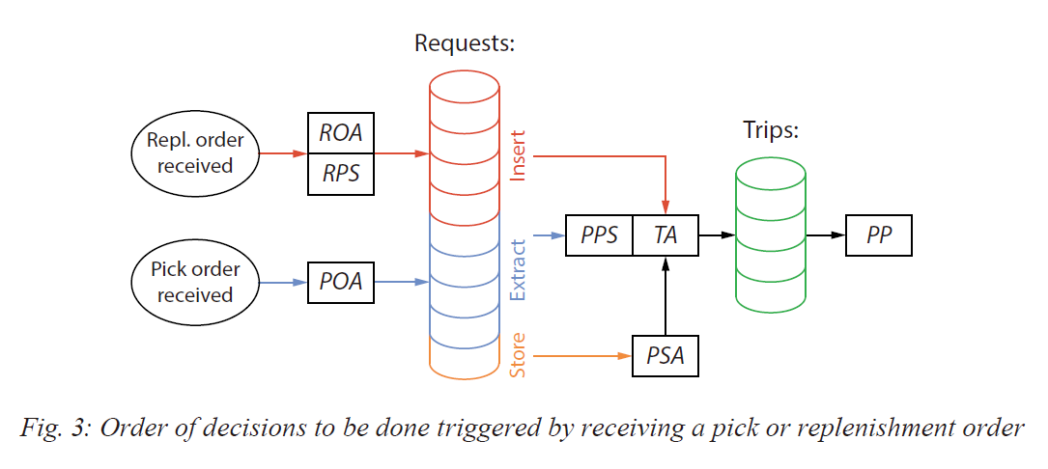
2. Proposal – Item classification
Ideas
Develop Initial State
Add different distribution of items in RAWSim-O
Simulate several distribution → Find optimal clustering model
Learning Clustering Model from other Input as well as Frequency
Apply similarity value of three Items rather than just two
Use not A Pod, but several Pods
Develop Decision Rule Modeling
Add Pod Storage Assignment Rules¹
Arrange pods in inventory area based on frequency
In RAWSim-O : Random, Fixed, Nearest, Station-based, Class

Slide 11
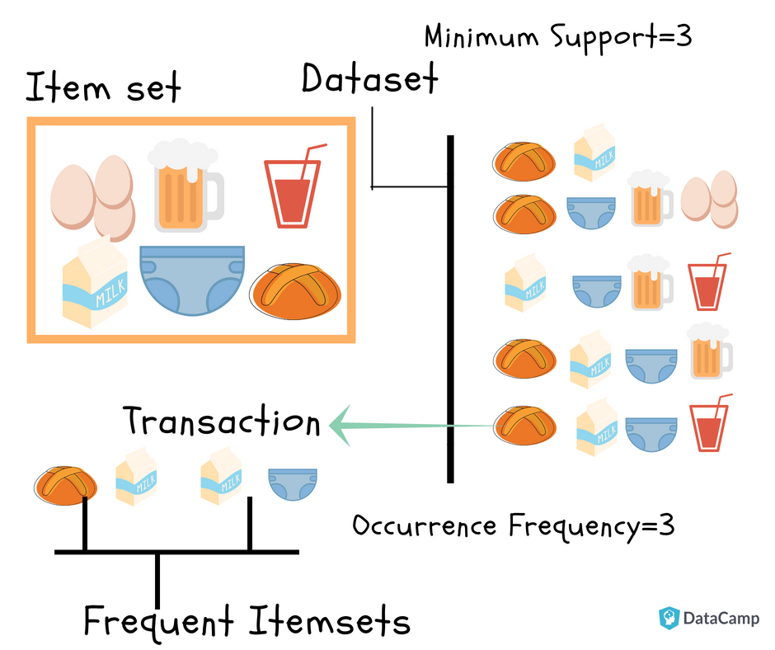
3. Proposal - Association Analysis of Item for PSA
Association Analysis of item for PSA
Find association of products through the Market basket analysis
Use it for the Pod Storage Assignment Rule
2 Constraints
Place the related product nearby
Place the unrelated products faraway

Slide 12
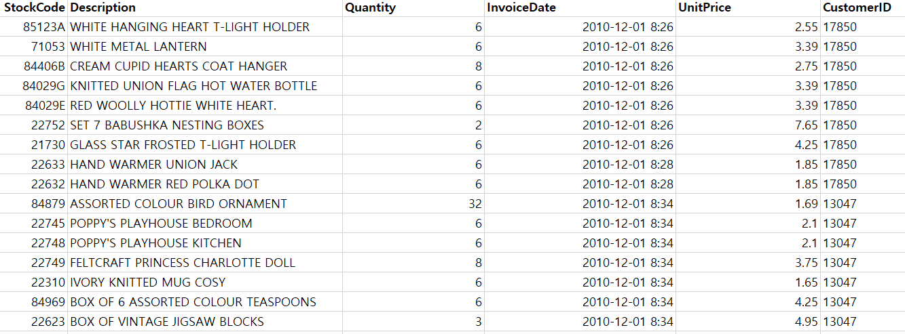
3. Proposal - Association Analysis of Item for PSA
Dataset (from Kaggle)
Online Retail (https://www.kaggle.com/puneetbhaya/online-retail)
Product ID
Product Name
Customer ID
Sum of the # of same customer’s Product ID = Shopping cart of one person

Slide 13
3. Proposal - Association Analysis of Item for PSA
Market Basket Analysis
Apriori Algorithm
finding frequent item sets in a dataset using prior knowledge of frequent itemset properties.
Limitiation : Slow for large item sets
Hruschka, H. (2014). Analyzing market baskets by restricted Boltzmann machines. OR spectrum, 36(1), 209-228.
Using Neural Network
Benefit
Reduce unnecessary movement of the robot
Raise Efficiency of the Path Planning
Limitation
Dataset is about online retail NOT about Customer
Need to find algorithm to optimize the hyperparameter

Slide 14
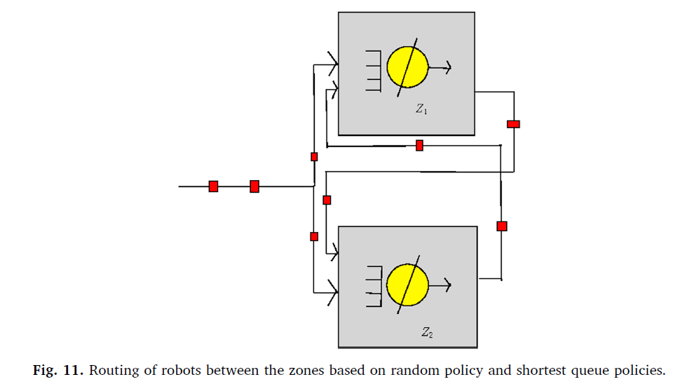
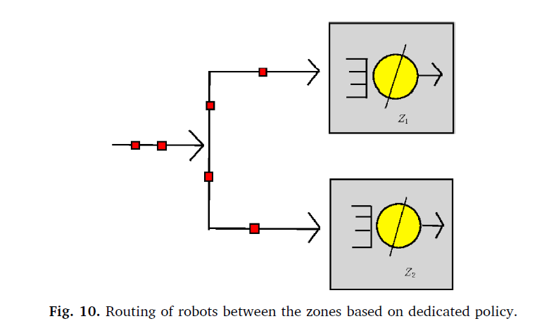
4. Proposal – Queuing Network Model
Existing Papers
“Decision rules for robotic mobile fulfillment systems” , M.Merschformann,…
Not using Queuing Model, detailed simulation
Robot-storage zone assignment strategies, Debjit Roy
Most of research are on strategic level
Set up Layout warehouse
Using Multi-class closed queueing network model
Compare our model with Pooled Robot and Dedicated Robot
How to return to storage zone from order and replenishment station,
Robots active according to stochastic model
기존 대기열 pooled robot 이론

Slide 15
4. Proposal – Queuing Network Model
Idea
Access Pooled Robot vs. Dedicated Robot in RAWSim-O
Add Decision Rule
PSA
ROA and POA
Decide the optical size of priority zones in PSA

Slide 16
Summery
Proposal | RAWSim-O | Env | Method | Expected Effect | Limitation
Deep RL | X | Python, Unity | Reward/ Max cost (Action) | High Efficiency | Little RL background, Source Code
Item Classification | O | C# | Item Initial Station & PSA | Complexity of Model
Association Analysis of item | O | C#, python | PSA | Reduce unnecessary robot path | Hard to fit Model using Dataset

